Slide 1

Willow Bank Junior School
Year 2 Transition
2026

Slide 2
Welcome!

Slide 3
A copy of this information can be found at:
www.willowbankjunior.com
Children
Class pages
Year 2 Transition

Slide 4
Staffing 2025/6:
Staffing 2026/7: tbc
Mrs Burns and Mrs Cowen & Teaching Assistants
Children will visit the school:
Wednesday 15th July (PM)
They will have an outdoor tour, activity & story.
Pick-up from Infants at 3:15pm.

Slide 5
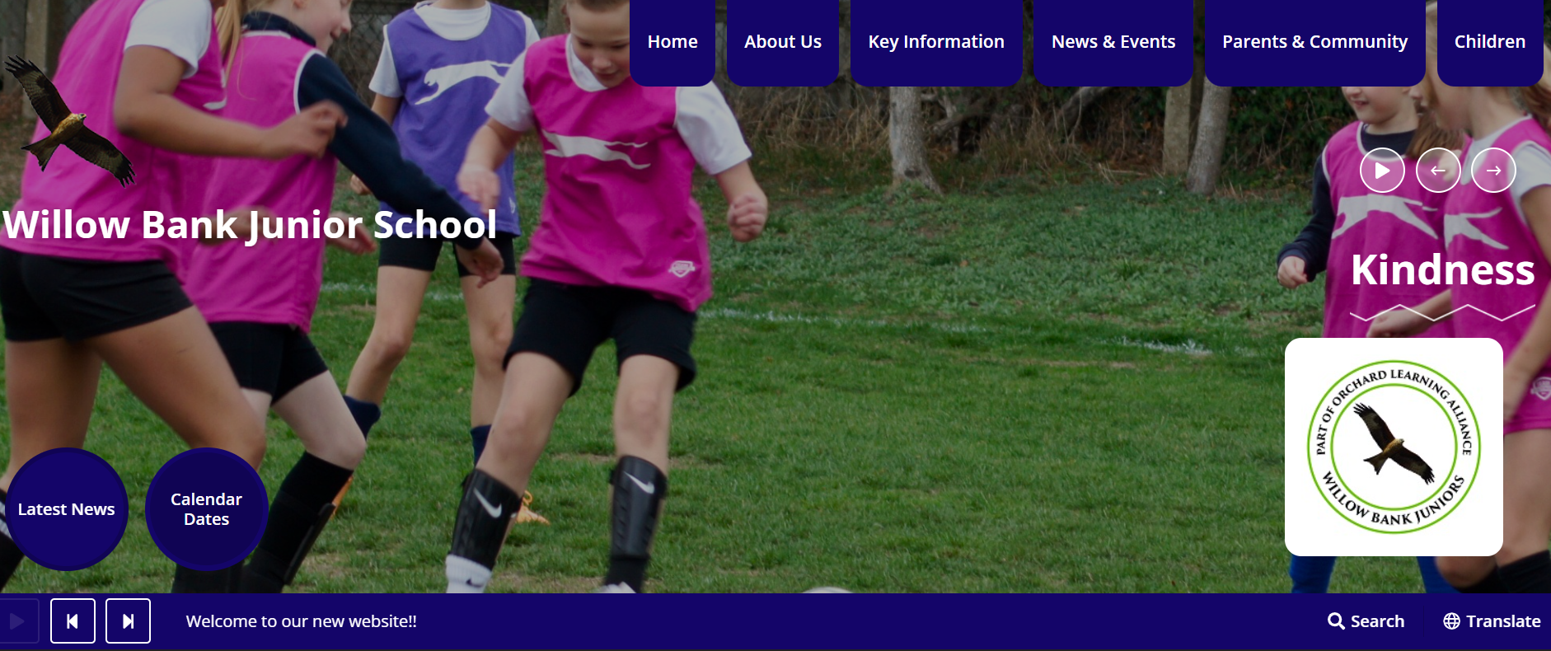

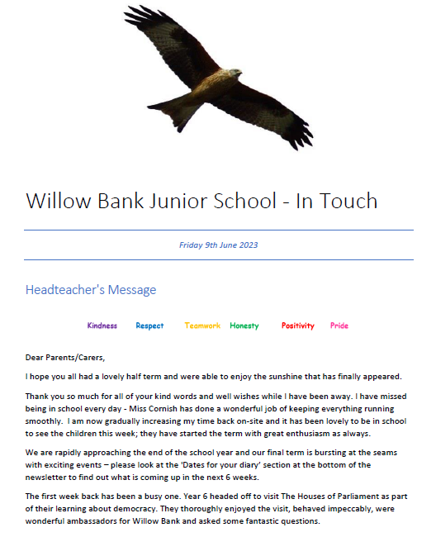


Communication
School Website
Arbor
Scopay (link form is in your pack)
In Touch
Instagram
At the door
Email:
admin@willowbank-jun.wokingham.sch.uk

Slide 6
The School Website
https://www.willowbankjunior.com/

Slide 7

School Uniform
Cardigan & sweatshirt sizes are currently on a rail in Reception, for children to try on.
Deadline for deliveries to school before summer: Midnight on Thursday 9th July (home deliveries take 5-7 working days).
Goodies website details on the school website/QR codes in your pack.

Slide 8
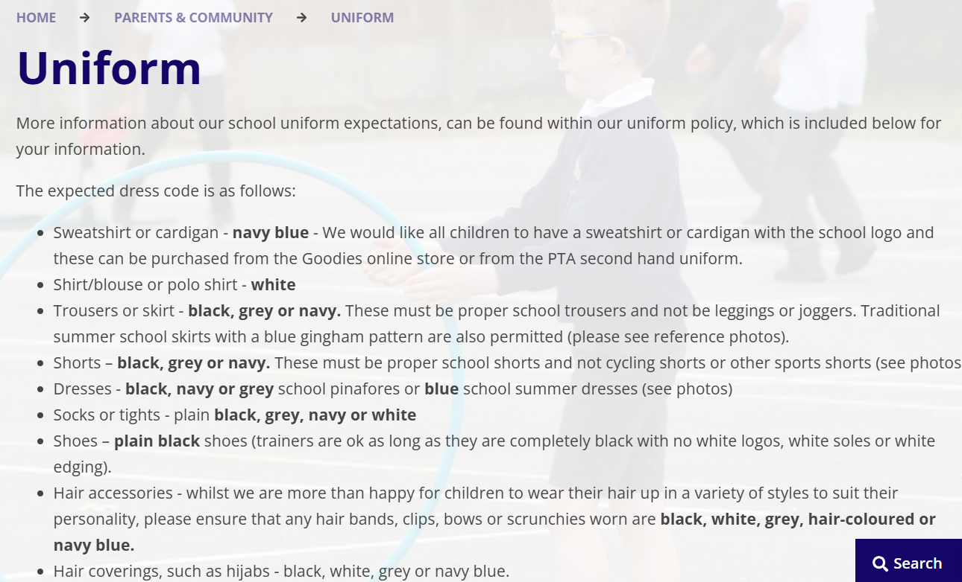
School Uniform
Uniform policy is on the school website.
www.willowbankjunior/uniform

Slide 9
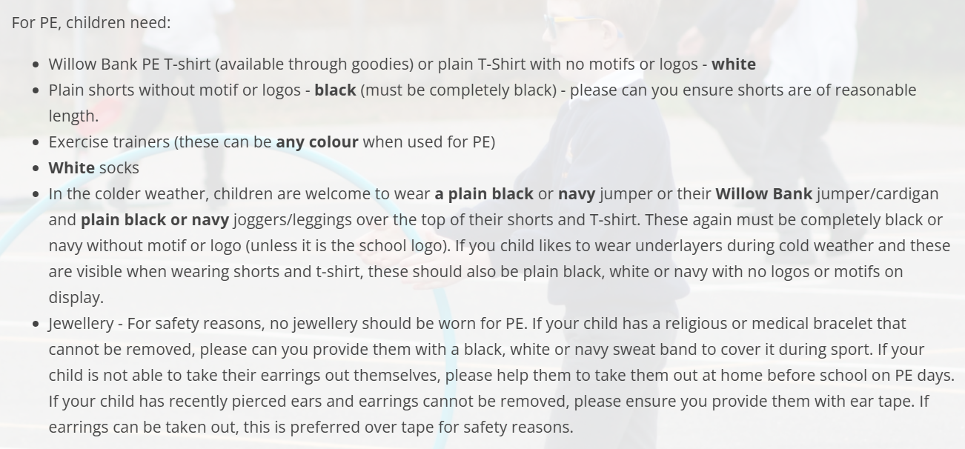
School Uniform
Uniform policy is on the school website.
www.willowbankjunior/uniform

Slide 10
Second-hand uniform sale
Second-hand uniform on sale this evening:
£2 per item (school logo)
The rest are individually priced

Slide 11
Start of Term
Wednesday 2nd September
@8:45am
A hand bell will ring in the playground, children will line up in classes.
Oak & Ash (year 3) are the 2 lines nearest the large playground.

Slide 12
What to bring to school
A named, refillable water bottle
School bag (small bag)
Small pencil case with coloured pencils only (to be kept in school bags). All other stationery will be provided by school.
All named please!

Slide 13
Food
Hot lunches need to be paid for at least 1 day in advance (through Scopay – information in your pack)
Cost in September £2.80
Packed lunch – nut free
Healthy snack for break - real fruit/veg, cheese, crackers, bread sticks
Please note:
Eligibility for Free School Meals is changing from September to include anyone claiming Universal Credit – an email will be sent to you separately.

Slide 14
Milk
Forms are in your pack
Around £20 per child, per term
Any questions, ask/email the office team, at
admin@willowbank-jun.wokingham.sch.uk

Slide 15
End of the school day
3:15pm
Parents & carers wait on the playground.
Children exit year 3 class doors on to the playground, met by an adult.
Email/call the office if normal collection arrangements change.

Slide 16

JAG – Junior Adventures Group
Before-school, after-school and holiday activity club.
Activity leaders will bring year 3 children to the playground (AM) and pick them up from classes (PM).
Contact them directly for further information.

Slide 17

First Aid Communication
The school office will notify you immediately about:
Serious injuries and all head injuries
Class teacher will notify you at the end of the school day about:
Minor injuries (bumps, grazes, bruises etc)

Slide 18
Example of Year 3 timetable:
A Year 3 Example Weekly Timetable
 | 9:15 – 9:45 | 9:45 – 10:45 | Break | 11:05 – 12:05 | Lunch | 1:05 – 3:15
Monday | Reading & phonics | English |  | Maths |  | P.E. | French |  | Music | Story
Tuesday | Reading & phonics | English |  | Maths |  | Science |  |  |  | Story
Wednesday | Reading & phonics | English |  | Maths |  | PSHEC | Computing |  |  | Story
Thursday | Reading & phonics | English |  | Maths |  | History |  | P.E. |  | Story
Friday | Reading & phonics | English |  | Maths |  | Art |  |  |  | Story
B Year 3 Example Weekly Timetable
 | 9:15 – 9:45 | 9:45 – 10:45 | Break | 11:05 – 12:05 | Lunch | 1:05 – 3:15
Monday | Reading & phonics | English |  | Maths |  | P.E. | French |  | Music | Story
Tuesday | Reading & phonics | English |  | Maths |  | Science |  |  |  | Story
Wednesday | Reading & phonics | English |  | Maths |  | Religion | Computing |  |  | Story
Thursday | Reading & phonics | English |  | Maths |  | Geography |  | P.E. |  | Story
Friday | Reading & phonics | English |  | Maths |  | Design & Technology |  |  |  | Story

Slide 19



Weekly Homework
Reading – at least 4 x per week written by an adult into Reading Records (Accelerated Reader scheme)
Maths – Times tables (Times Tables Rock Stars)
Spellings – quiz on Purple Mash (they also need to practise in their spelling homework books)

Slide 20
Current Extra-Curricular Activities
(paid and free)
Sport: football, tag-rugby, netball, athletics, running, rounders, chess, gymnastics, parkour, tennis, table tennis, cricket, break-dancing
Coding
Music: 3 x choirs, recorders, orchestra, Berkshire Maestros
Drawing/art
Sewing
Games & Chill
Drama
Environment Club

Slide 21
Any questions?

